Slide 1
Prepared by:
Mohammed Faisal AlQahtany
Select the optimal locations to build café in Riyadh using MCDM & GIS
capacitymedia.com

Slide 2
Output
(Selece the optimal locations for Café in Riyadh)
Data
Implementation using GIS
MCDM & AHP

Slide 3
Data
1) Café Layer for Riyadh city Obtained from Google maps and changed from table to points with latitude, longitude in GIS
5) Roads layer obtained from open source , contains of Riyadh Main Roads
2) Gardens Layer obtained from open source used as one of the important criterions in this project
4)Population & neighborhoods layer , obtained from the royal commission of Riyadh city contains new Riyadh neighborhoods, while the population I enter them manually using the Saudi Census 2022 Data inside the layer
3)Educational services layer obtained from the royal commission for development of Riyadh city contains all the educational services (schools,colleges , universities, public and private schools…etc)
Open source : gis4u.com

Slide 4
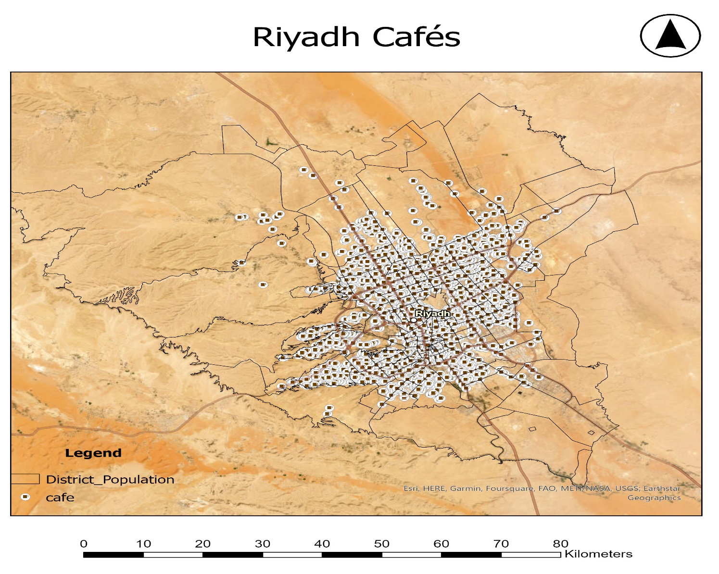
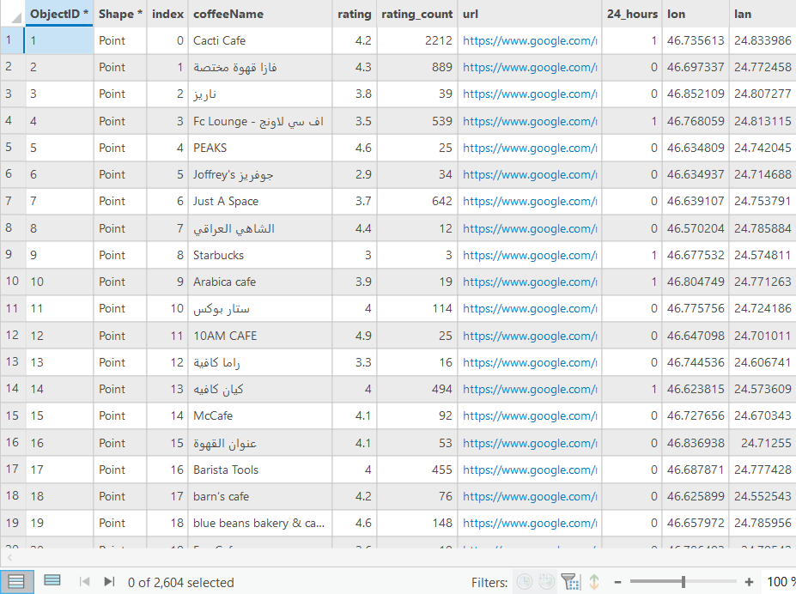
1) Café Layer for Riyadh city Obtained from Google maps and changed from table to points with latitude, longitude in GIS .

Slide 5
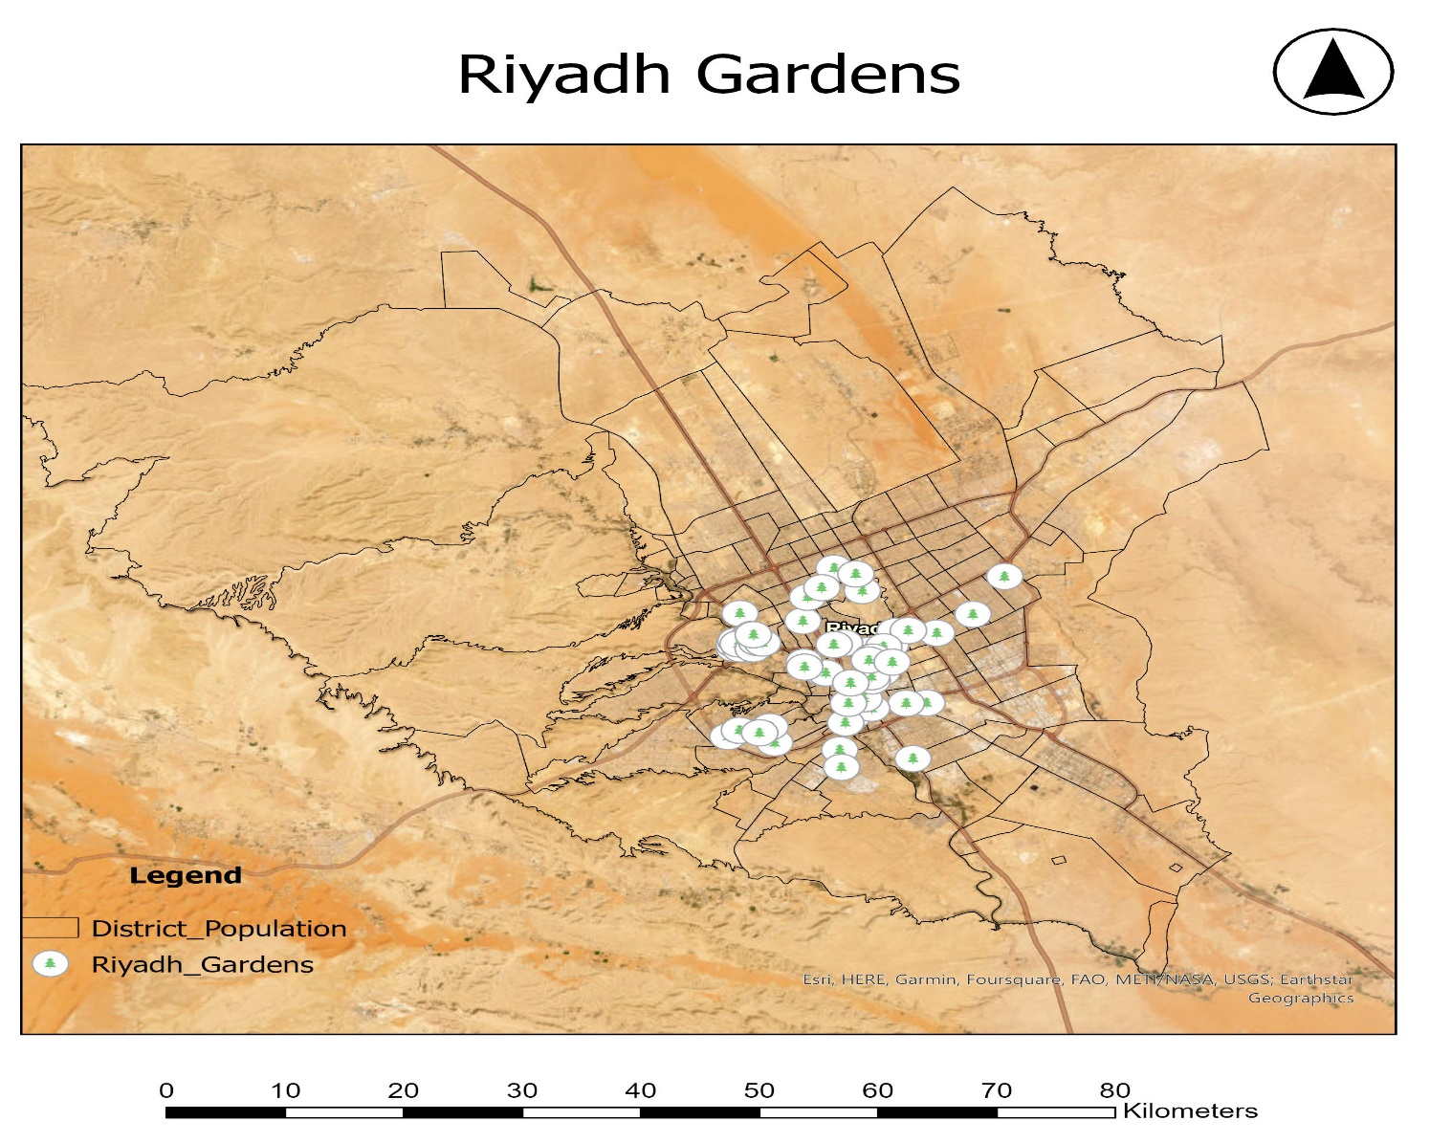
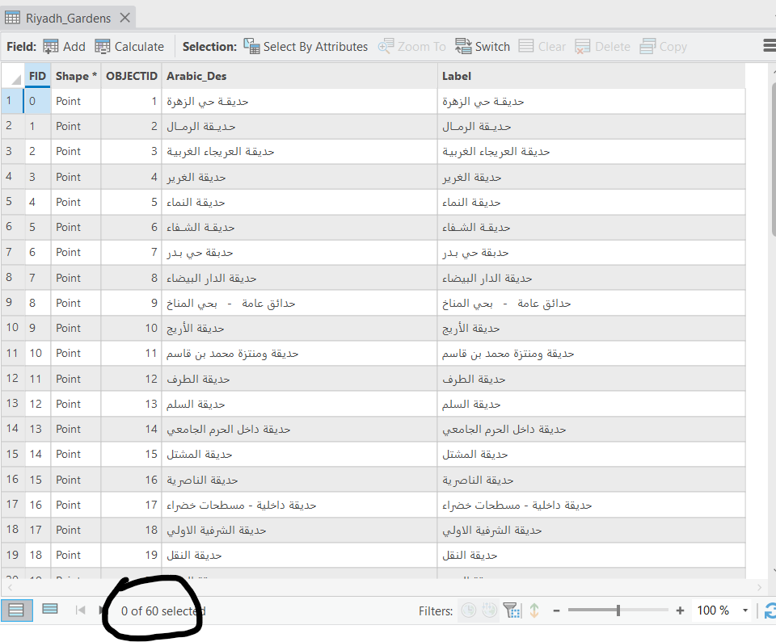
2) Gardens Layer obtained from open source used as one of the important criterions in this project, I chose Gardens because I target the athletic people generally walkers , footballers , picnic families , they often need café nearby and café will be successful in such spot.

Slide 6
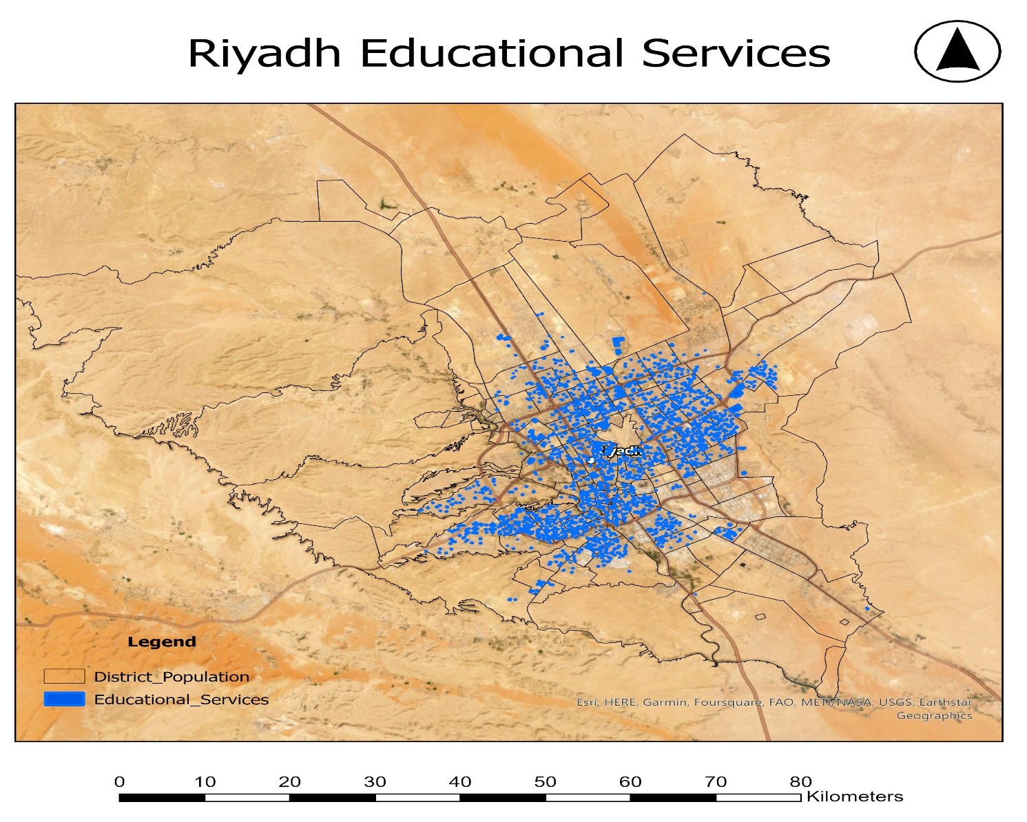
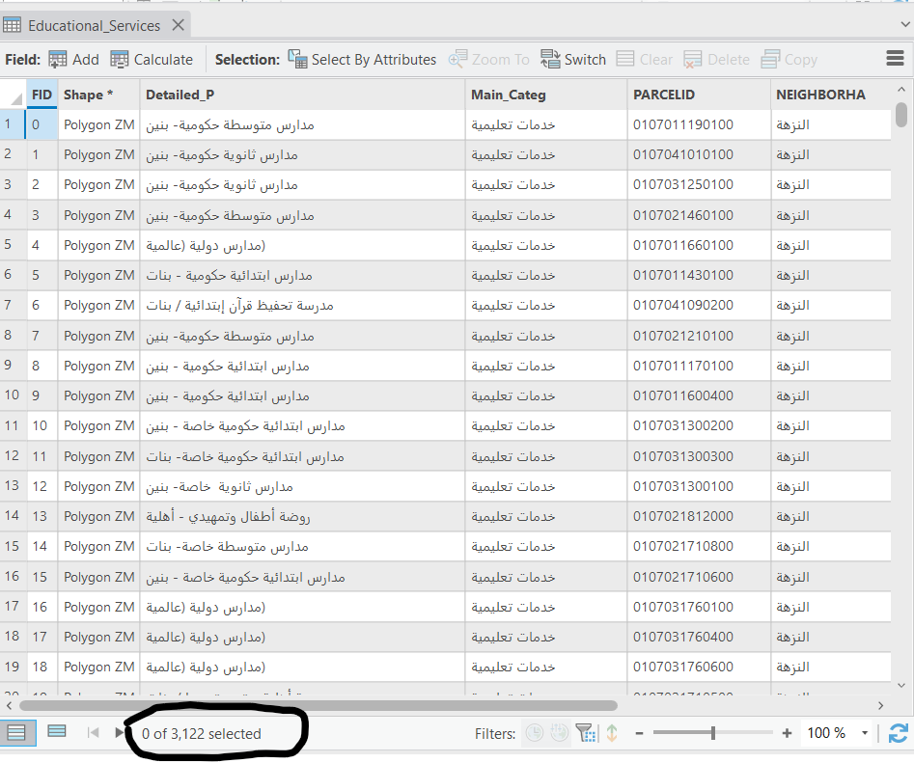
3)Educational services layer obtained from the royal commission for development of Riyadh city contains all the educational services (schools,colleges , universities, public and private schools, Quran schools…etc
I am targeting students, teachers , workers from all ages nearby

Slide 7
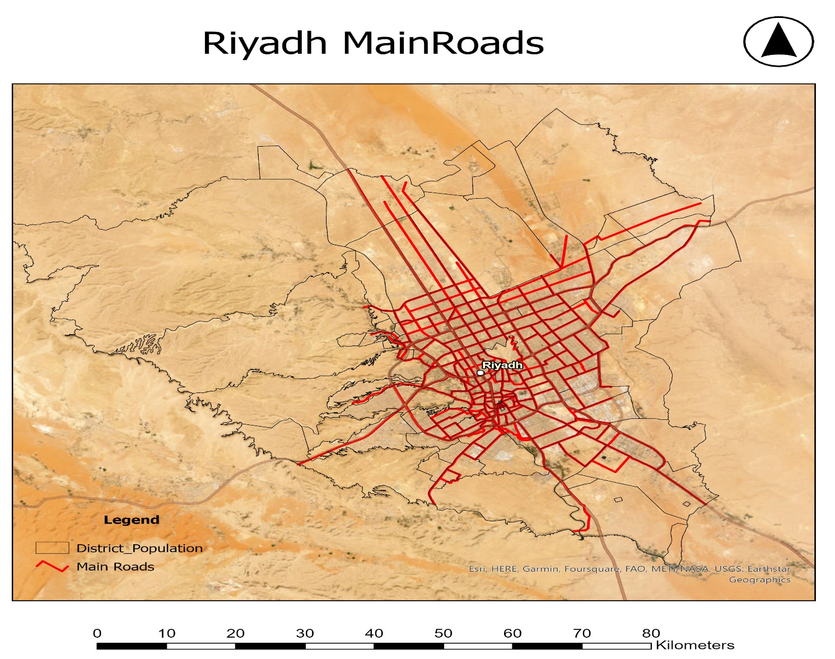
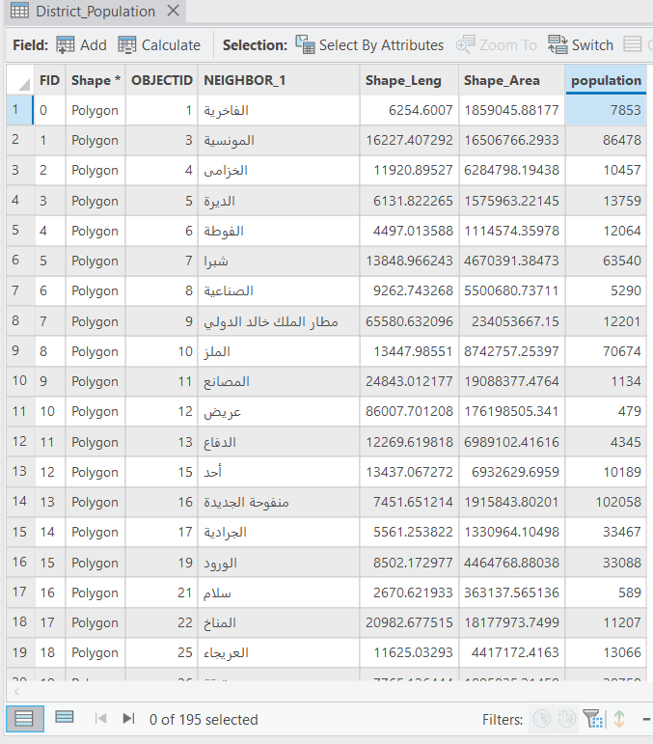
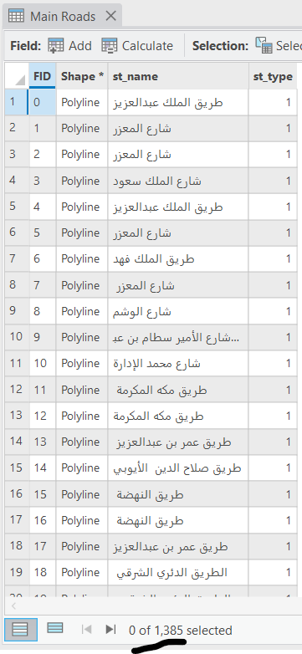
4)Population & neighborhoods layer , obtained from the royal commission of Riyadh city contains new Riyadh neighborhoods, while the population I enter them manually using the Saudi Census 2022 Data inside the layer
5) Roads layer obtained from open source , contains of Riyadh Main Roads

Slide 8
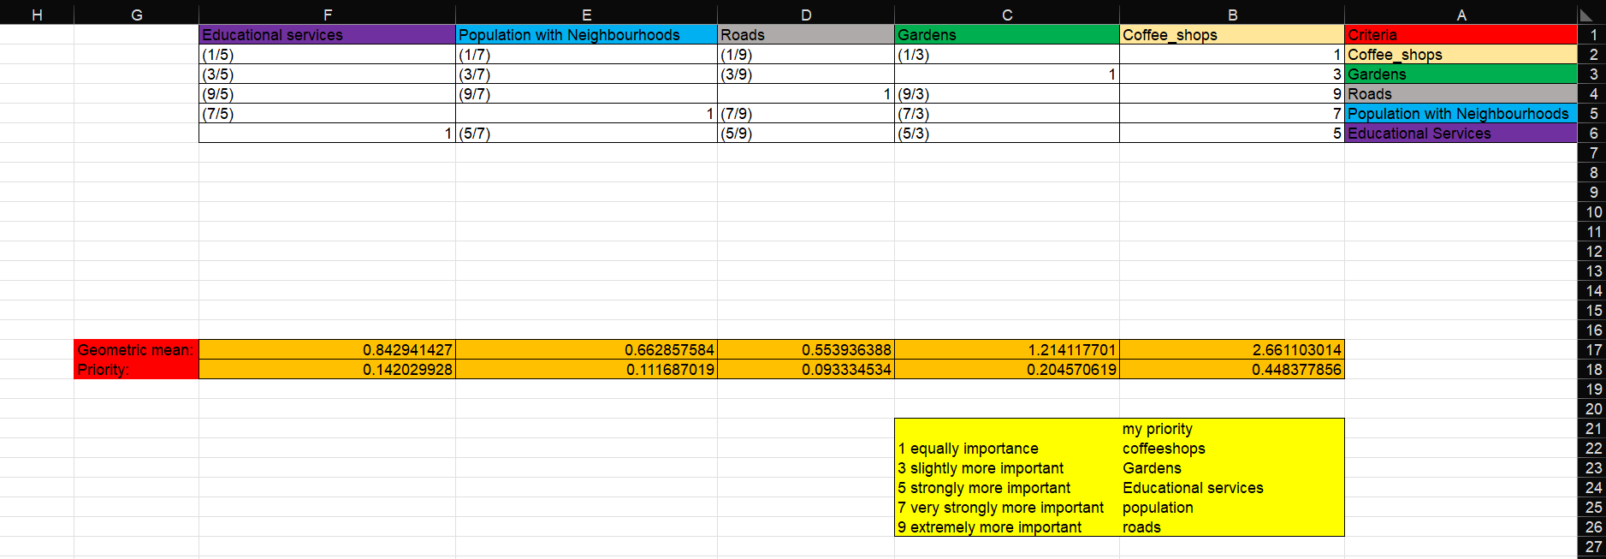
My Goal for this project
Select the optimal locations and see if there is suitable locations based on the criteria I chose, and the weights I determined, also based on my needs and common sense, So I give the DF Cafés the highest priority , then Gardens , then Educational Services, then Population and finally the roads. I used MCDM & AHP for determine the weights and prioritize them

Slide 9
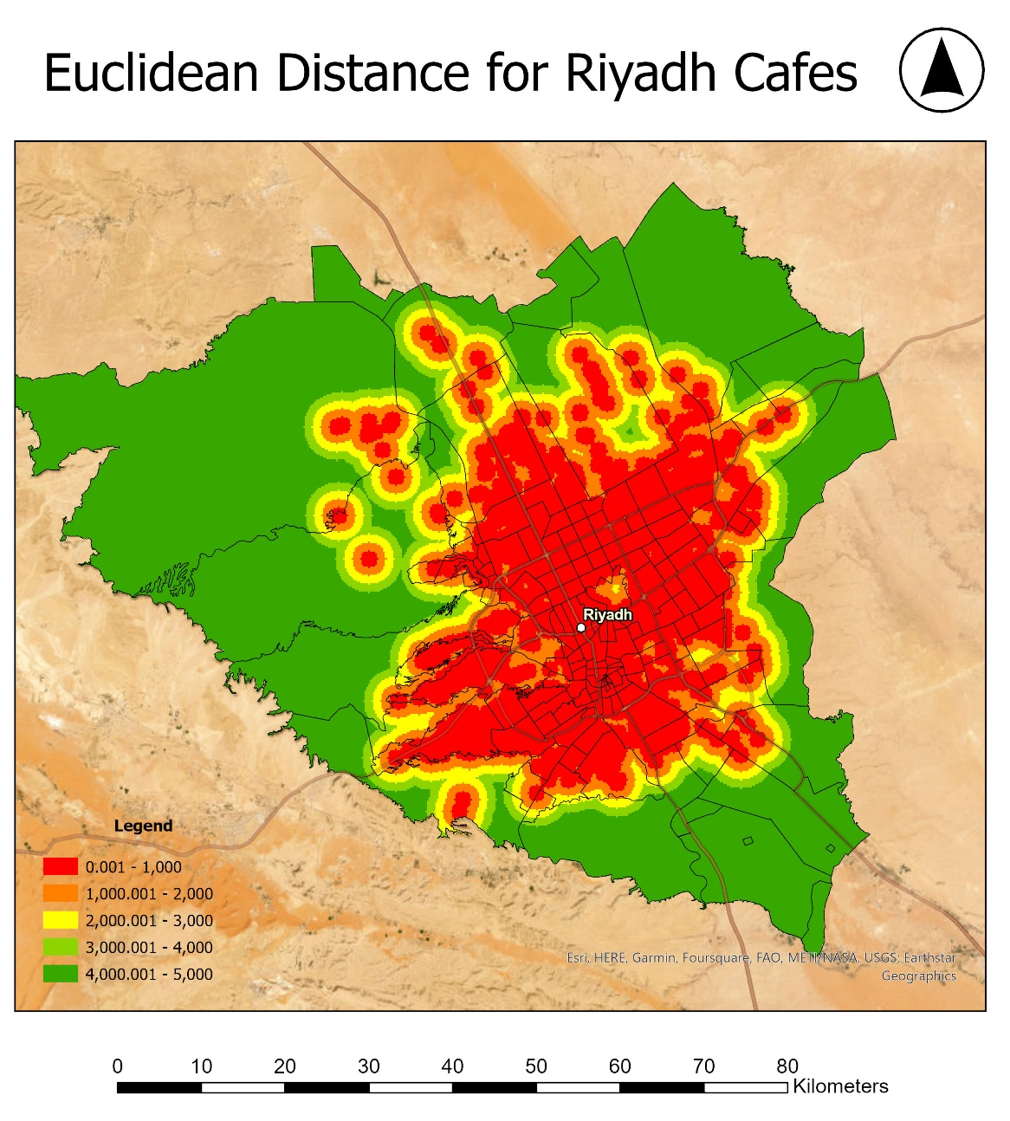
The figure shows Euclidean Distance for Cafes , The further the better with min. distance 1km

Slide 10
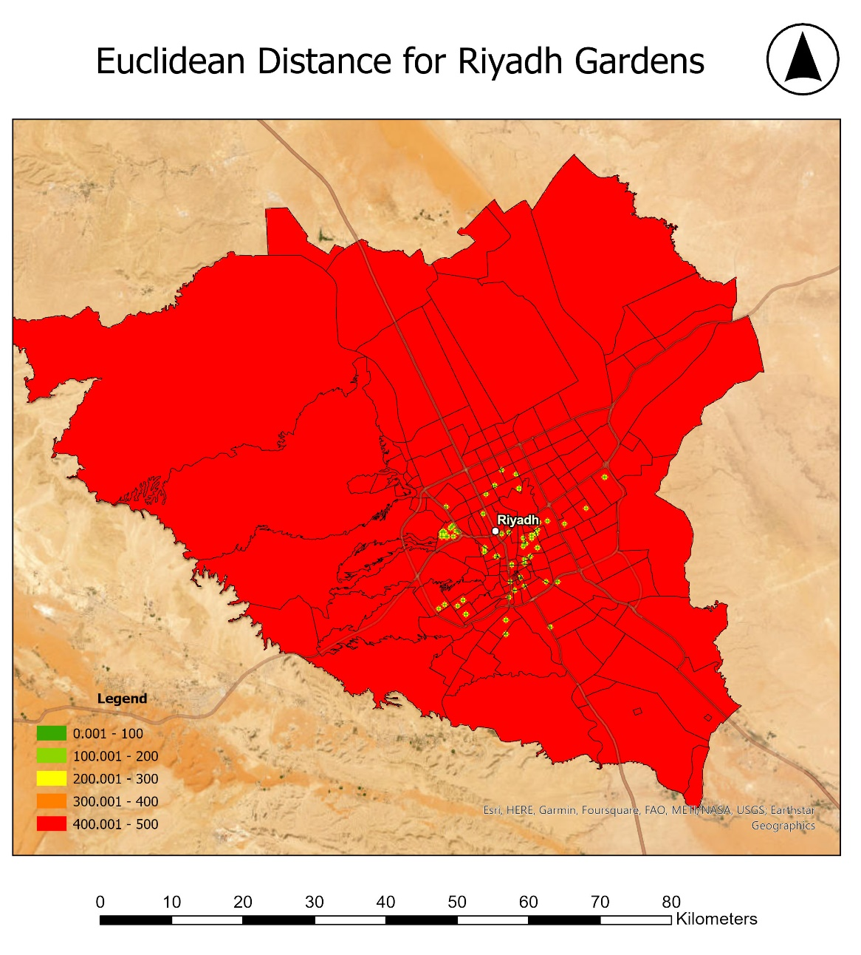
Figure shows Euclidean Distance for Gardens , The nearer the better for my café with minimum distance 100 meters

Slide 11
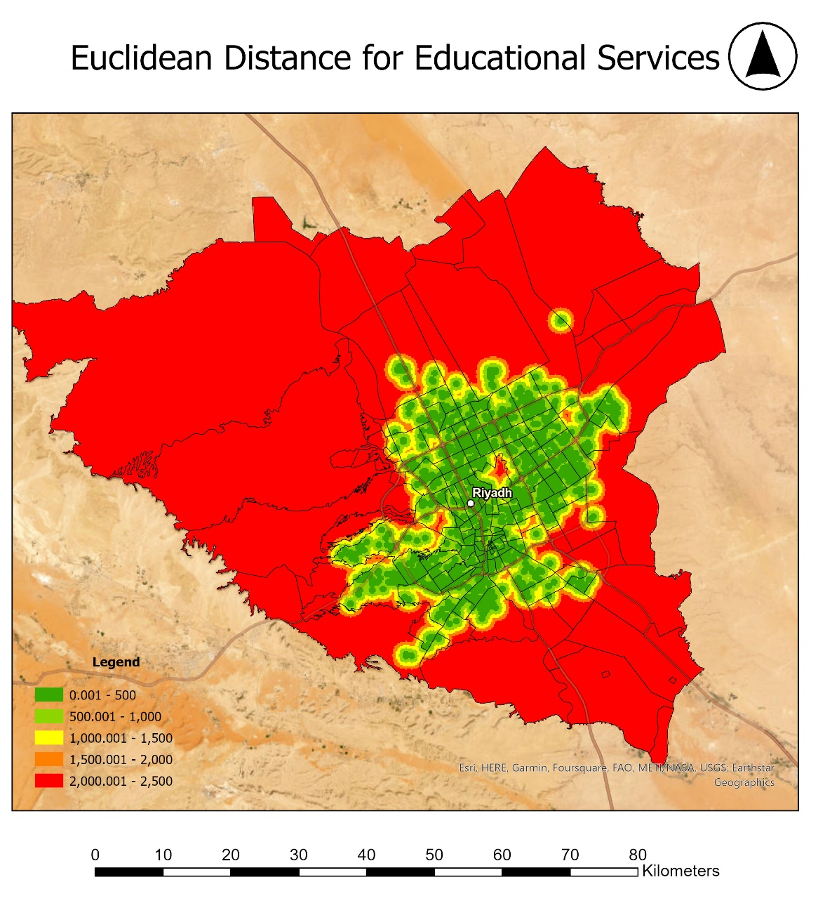
Figure shows Euclidean Distance for Educational Services , The nearer to Educational services the better for my café with minimum distance 500 meters

Slide 12
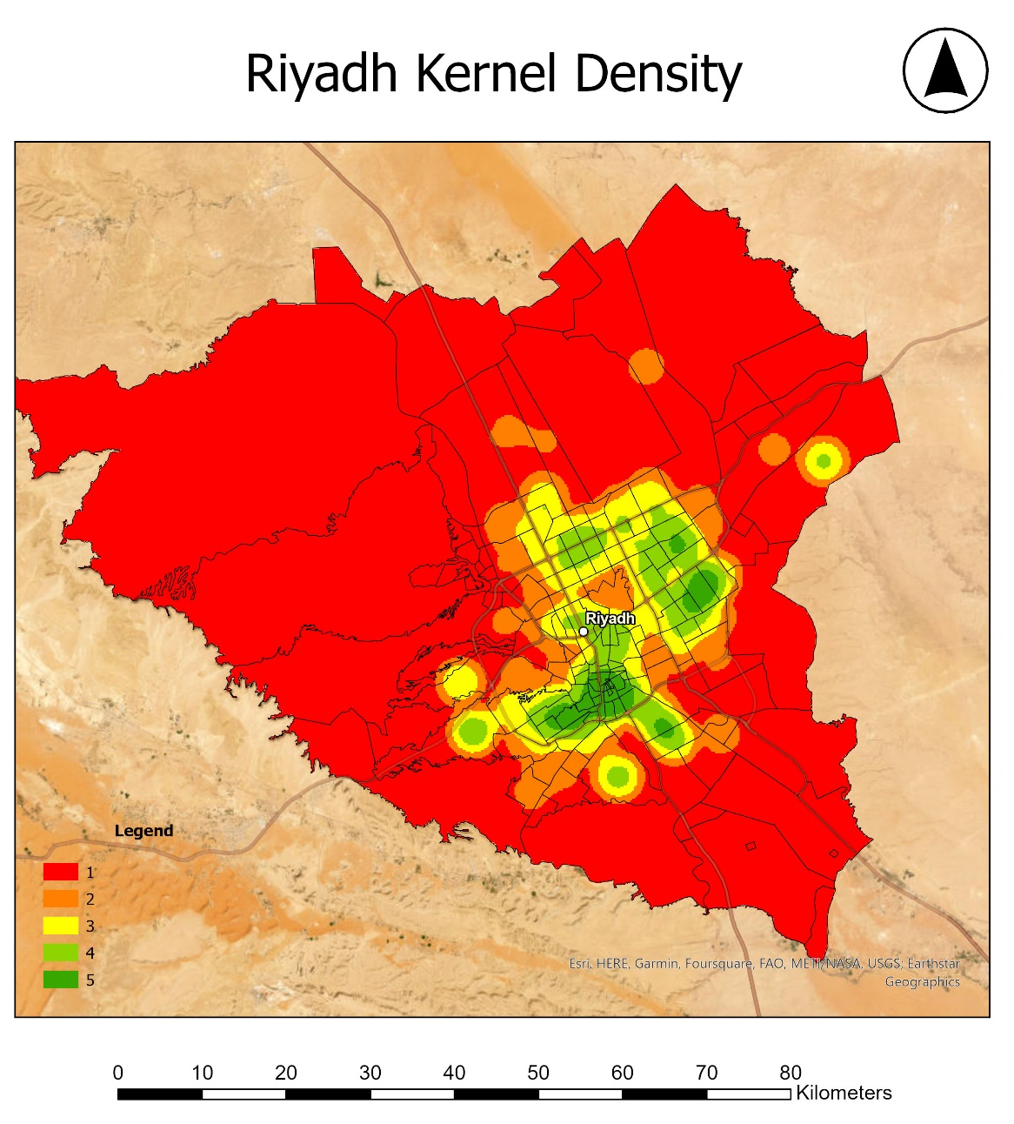
Figure shows Kernel Density , The green color is high densely areas while red is low densely areas , the higher the better

Slide 13
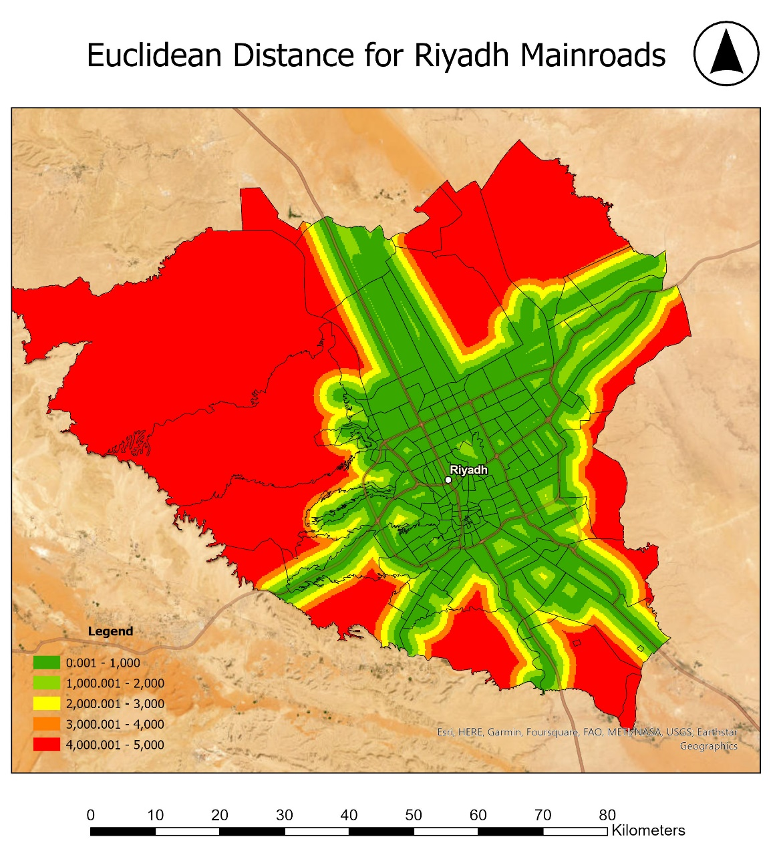
Figure shows Euclidean Distance for Mainroads , The nearer the better with minimum distance of 1 km

Slide 14
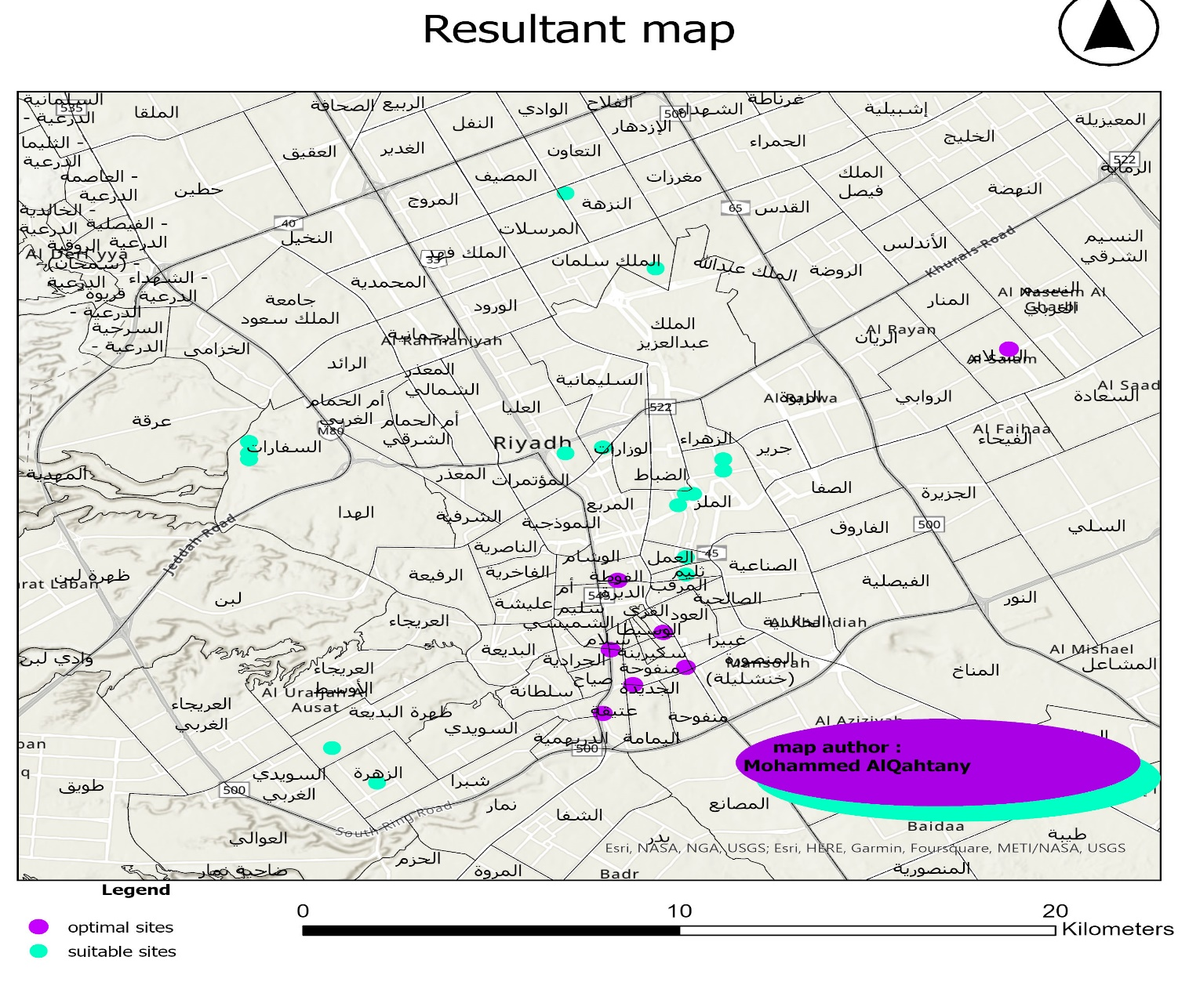
Result
After applying spatial analysis tools to the layers and merge them to get the resultant map. The resultant map has 23 sites in total around the city , 7 of them are optimal sites for building Cafés and 16 are suitable sites .

